Slide 1
MIESF Annual Member Investment update 30 June 2021
MIESF Net Assets: $944 million dollars
Invested across 2 options: MySuper and High Growth
    MySuper total assets: $907 million
    High Growth total assets: $37 million

Slide 2
MIESF MySuper Strategic Asset Allocation (SAA) as at 30 June 2021
The SAA is the road map that guides MIESF towards achieving the investment objectives for MySuper of;
Short term: Avoiding a loss each year and declaring a positive return; and
Long term: Beat inflation or CPI +2% p.a. net of fees and tax over rolling 10 year periods

Slide 3
MIESF MySuper SAA for the year ending 30 June 2021: actual v benchmark
The SAA is the road map that guides MIESF towards achieving the investment objectives for MySuper of;
Short term: Avoiding a loss each year and declaring a positive return; and
Long term: Beat inflation or CPI +2% p.a. net of fees and tax over rolling 10 year periods

Slide 4
MIESF MySuper Net Returns (after fees & tax) for the year ending 30 June 2021 by asset class compared to the benchmark gross returns for each asset class
Note: past returns are no guarantee of future performance and investment returns should not be relied upon as a guide to future performance.

Slide 5
MIESF MySuper and Pension section Net Returns for the year ending 30 June 2021 (p.a.)
The red dash line represents the average inflation rate (CPI) over 10 year period of 1.8% p.a. to 30 June 2021. The investment objective of MySuper is to beat CPI by 2% over this period which was 3.8% p.a. (blue dash line). The net return of 8.6% exceeded CPI+2% or 3.8% by 4.8% p.a. over the 10 years. MIESF MySuper has achieved this objective together with declaring a positive return for the year ending 30 June 2021. The net return for the Pension section was higher as no tax applies to investment earnings when members are in the pension section.
Note: past returns are no guarantee of future performance and investment returns should not be relied upon as a guide to future performance.

Slide 6
MIESF MySuper Net Returns for the year ending 30 June 2021 compared to the various peer median returns (p.a.)
MIESF MySuper returned less than its peers for the one year, however over the 3,5, 7, 10 and 20 years its has exceeded its peers. Providing strong evidence of good long term performance for its members.
Note: past returns are no guarantee of future performance and investment returns should not be relied upon as a guide to future performance.

Slide 7
MIESF High Growth Option SAA as at 30 June 2021
The SAA is the road map that guides the High Growth Option to achieve the investment objectives of;
Providing capital growth over rolling seven-year periods measured at each 30 June; and
Beating inflation or CPI +4% p.a. net of fees and tax over rolling 10 year periods
Achieve a total net return greater than the median return of the Growth option in the SelectingSuper surveys over rolling 5 years to 30 June each year.

Slide 8
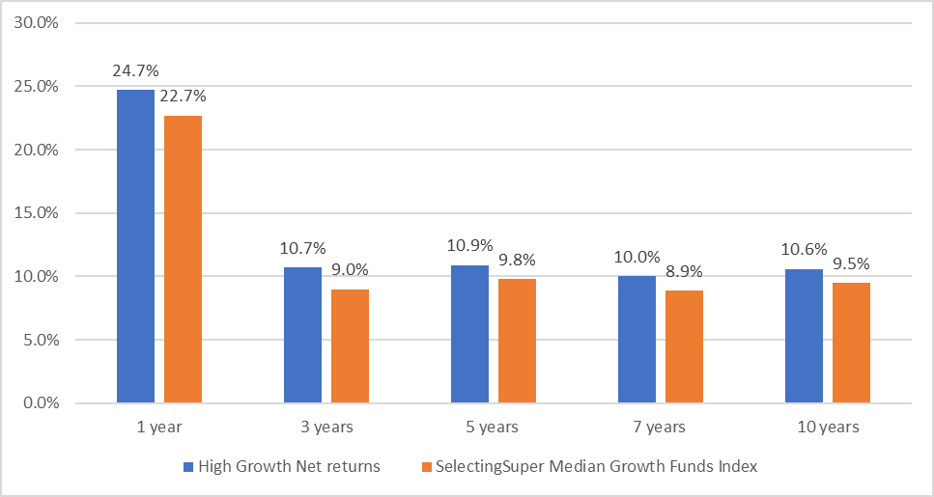
MIESF High Growth Option net returns compared to SelectingSuper Median Growth Funds Index to 30 June 2021 (p.a.)
Note: past returns are no guarantee of future performance and investment returns should not be relied upon as a guide to future performance.

Slide 9
Economic Update
Inflation! Is it transitory or structural? Not too low, not too high but jut right! What is that number? Not 1% not 5% but around 3%?
Rising interest rates and impacts on record debt levels of companies and households!
Geopolitical tensions: China v's the Developed Countries namely US/UK/Japan/AUS: trade/tariffs/security
Moving to lower economic growth post the Covid19 stimulus/support: strong rebound in economic growth post covid 19 collapse, but this growth is expected to wane in late 2022 and beyond.
Rising unrest by ten of millions of workers without job security, declining real wages and left behind in the economic prosperity which has created record numbers of ultra wealthy.
MIESF remains cautious on the longer term outlook and expects lower returns going forward compared to the last 10 years

